Slide 1

APPLICATIONT OF MATHEMATICS
IN CANCER TREATMENT
Rajput Sugam Singh
22MAC1R22
National Institute Of Technology , Warangal
Department Of Mathematics
(Applied Mathematics)

Slide 2

Outlines
Overview
Reports on Cancer
Cancer Therapy
Radio Frequency Ablation (R.F.A.)
An Introduction
Bio-Heat Equation for cancer tumor
Mathematical Modelling
Press Information Bureau (P.I.B.) Report
◉ References
Tips for Caner Prevention

Slide 3

REPORT ON CANCER BY WHO
23 million people affected by cancer by 2030.
Cancer is a leading cause of death worldwide, accounting for nearly 10 million deaths in 2020, or nearly one in six deaths.
Breast (2.26 million cases)
Lung (2.21 million cases)
Colon and rectum (1.93 million cases)
Prostate (1.41 million cases)
Skin (non-melanoma) (1.20 million cases)
Stomach (1.09 million cases)

Slide 4
CANCER THERAPY
Standard Therapy
Surgical Treatment --> 75% to 90% not suitable
Transplantation --> Inadequate donors
Bridging Therapy
Limit cancer growth
Radio Frequency Ablation
Cryoablation
Micro Wave Ablation
Laser
Minimal Cancer Inversion Treatment
Recommended by Interventional radiology (IR)
Under Treatment
Recurrence of tumour
Over Treatment
Kills unnecessary cells

Slide 5
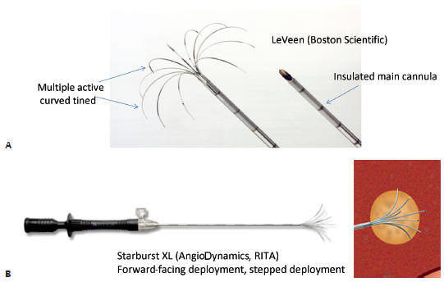
RADIO FREQUENCY ABLATION (RFA)
It‘s most common method for cancer treatment.
It requires more experienced Interventional Radiology (IR).
RFA Procedure
RFA Needle
Radiofrequency ablation (RFA) uses heat to destroy tissue.
Radio waves are sent through a precisely placed RFA needle (Umbrella Shaped) to heat an area of the nerve.
Radiofrequency ablation takes from 15 minutes to two hours to complete, depending on the treatment location and number of treatments performed.

Slide 6
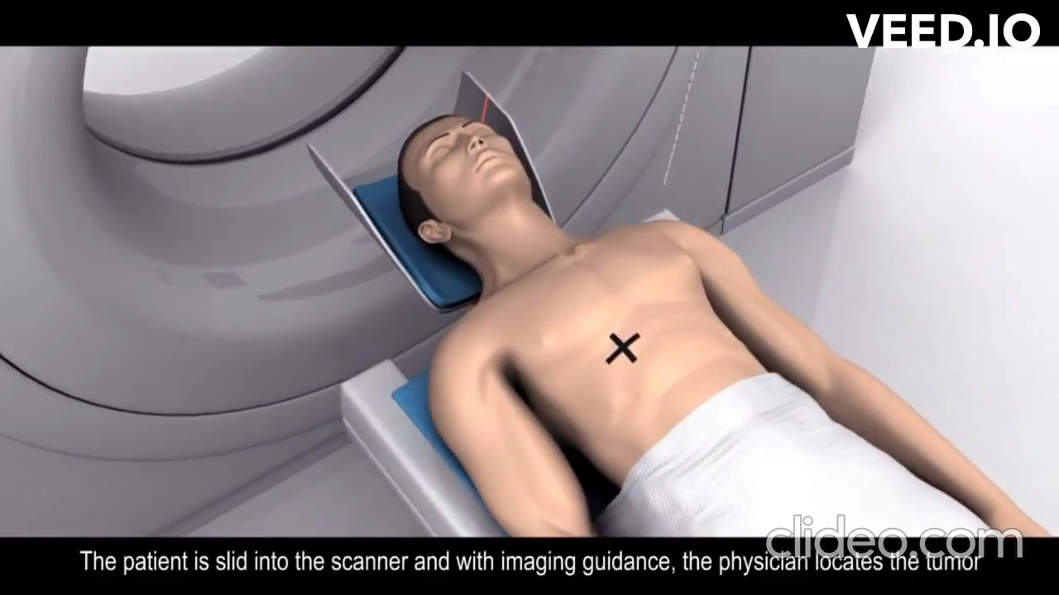
Animation of liver tumour RFA Treatment

Slide 7
Mathematical Statements for :
Heat transfer from RFA needle to the liver
Power generation or Heat Source from needle
Temperature controlled power supply
Cell death due to temperature

Slide 8
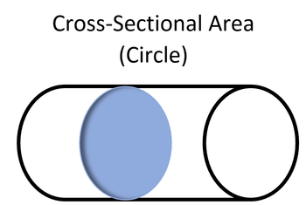
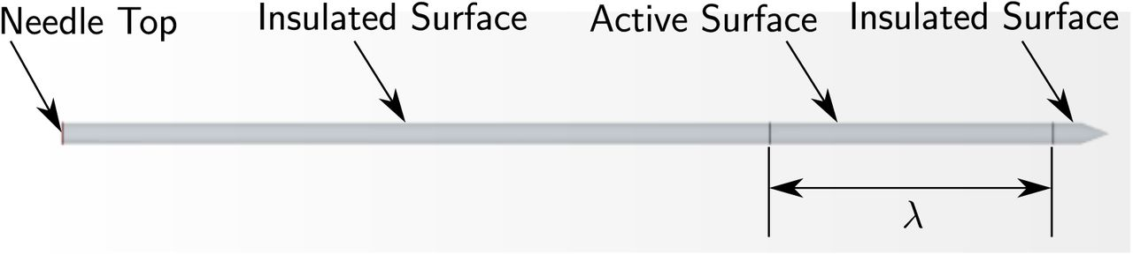
Mathematical Model For Heat Equation
Initial Assumptions
Heat flow in a solid rod with circular cross section A
Perfectly insulated rod, no heat escaped radially
Heat flow along the axis of symmetry of the rod
Initial temperature = Room temperature
Cross Section of RFA Needdle

Slide 9
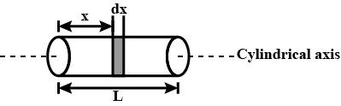
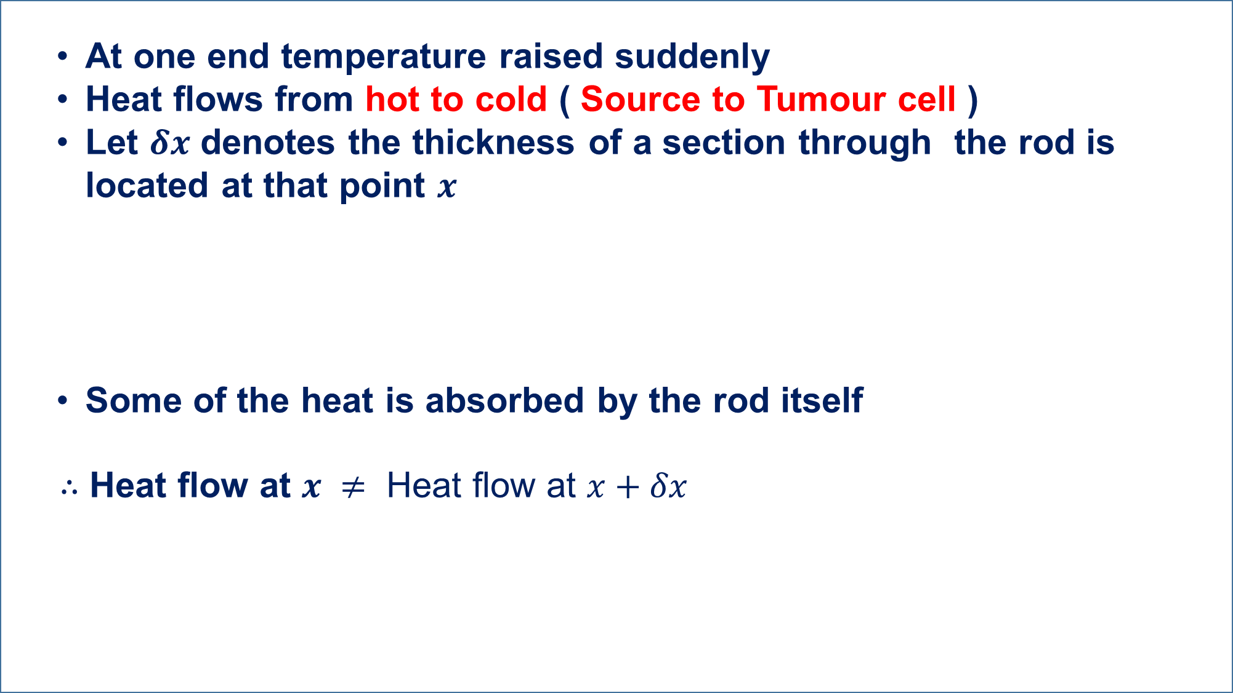
At one end temperature raised suddenly
Heat flows from hot to cold ( Source to Tumour cell )
Let $δx$ denotes the thickness of a section through the rod is located at that point $x$
Some of the heat is absorbed by the rod itself
$∴$ Heat flow at $x ≠$ Heat flow at $x+δx$
According to the law of conservation of energy
Rate of change of heat content = net rate of heat conducted in & out of the section

Slide 10
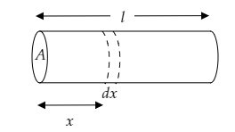
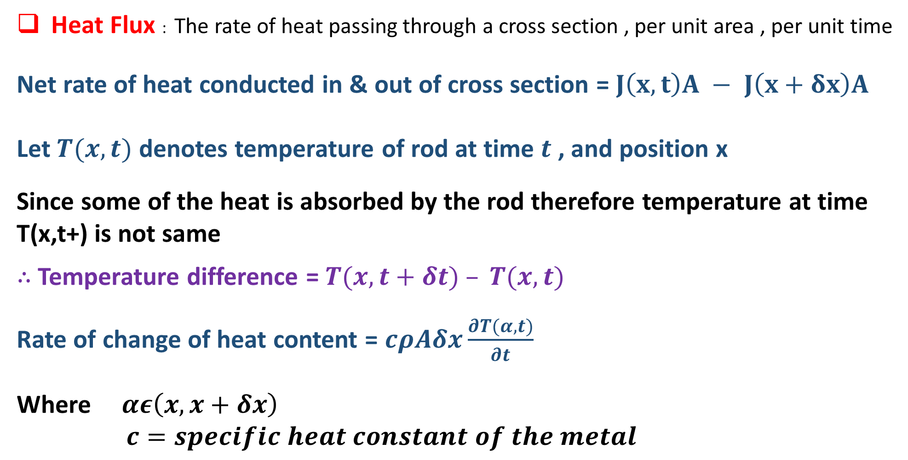
Heat Flux : The rate of heat passing through a cross section , per unit area , per unit time
Net rate of heat conducted in & out of cross section = $J\left(x,t\right)A − J\left(x+δx\right)A$
Let $T(x,t)$ denotes temperature of rod at time $t$ , and position x
Since some of the heat is absorbed by the rod therefore temperature at time T(x,t+) is not same
$∴$ Temperature difference = $T(x,t+δt) – T(x,t)$
Rate of change of heat content = $cρAδx\frac{∂T(α,t)}{∂t}$
Where $αε\left(x,x+δx\right)$
$c=specific heat constant of the metal$

Slide 11
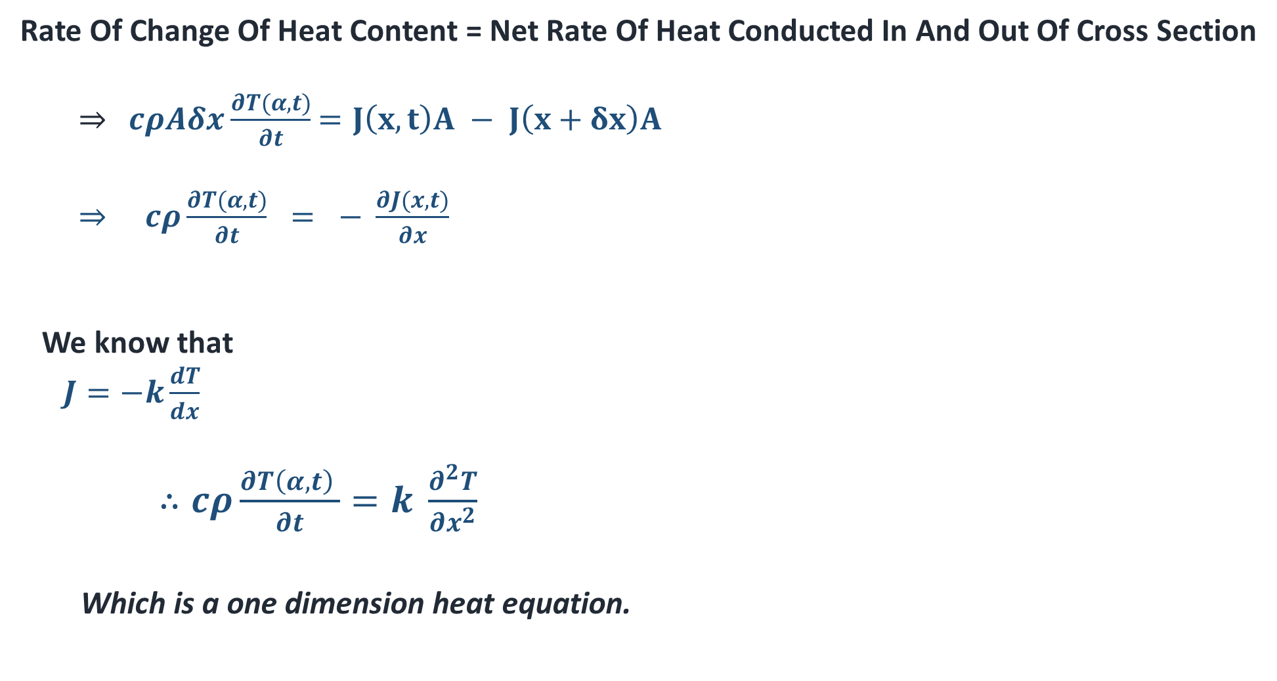
Rate Of Change Of Heat Content = Net Rate Of Heat Conducted In And Out Of Cross Section
$⇒$ $cρAδx\frac{∂T(α,t)}{∂t}$ $=J\left(x,t\right)A − J\left(x+δx\right)A$
$⇒ cρ\frac{∂T(α,t)}{∂t} = − \frac{∂J(x,t)}{∂x}$
We know that
$J=−k\frac{dT}{dx}$
$∴cρ\frac{∂T\left(α,t\right) }{∂t}=k \frac{∂^{2}T}{{∂x}^{2}}$
Which is a one dimension heat equation.

Slide 12
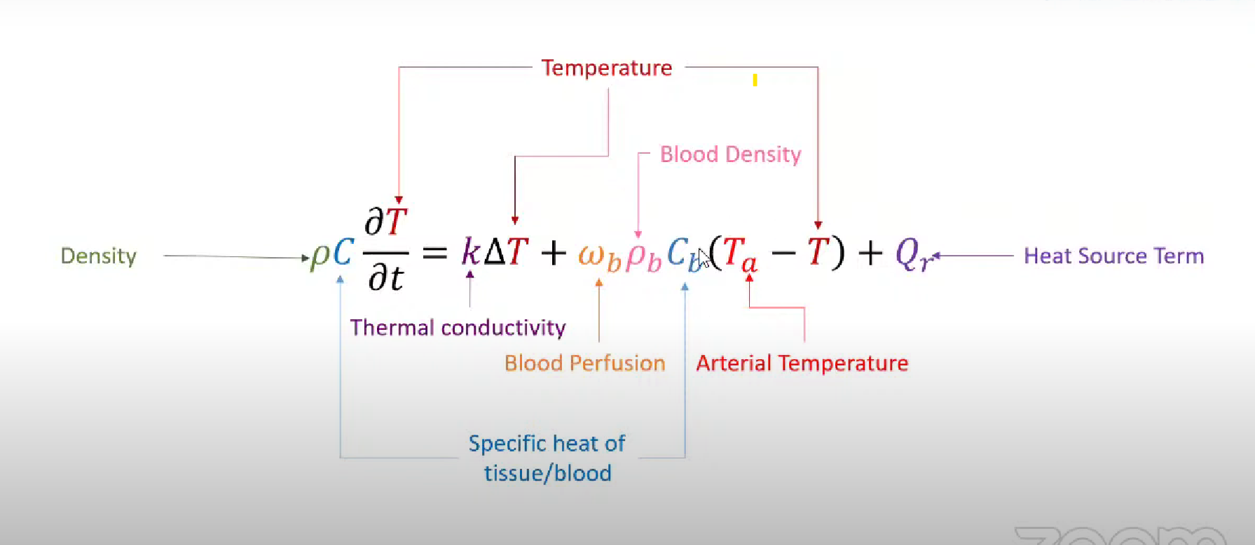
Bio Heat Equation

Slide 13
Tips For Cancer Prevention By Press Information Bureau( PIB )
Tips For Cancer Prevention By Press Information Bureau ( PIB )
Avoid Tobacco: Tobacco use, including smoking and chewing tobacco, is a significant risk factor for various types of cancer.
Physical Activity: Engage in regular physical activity or exercise. Aim for at least 150 minutes of moderate-intensity exercise or 75 minutes of vigorous-intensity exercise per week.
Limit Alcohol Consumption: Excessive alcohol consumption is linked to an increased risk of several cancers, including breast, liver, and colorectal cancer. Limit alcohol intake or avoid it altogether.
Occupational and Environmental Hazards: Minimize exposure to hazardous substances in the workplace and follow safety guidelines.
Education and Awareness: Stay informed about cancer prevention strategies, early warning signs, and risk factors. Educate yourself and others about cancer prevention to make informed choices.

Slide 14
Reference
, ,
, ,
Vahid Darvishi,Mahdi NavidBakhsh , Saeid Amanpour, “Heat and mass transfer in the hyperthermia cancer treatment by magnetic nanoparticles”
URL: https://www.ncbi.nlm.nih.gov/pmc/articles/PMC8624640/
National Cancer Institute
https://www.cancer.gov/about-cancer/treatment/types
Animation video of liver tumor radiofrequency ablation
(https://www.youtube.com/watch?v=ghMfRYiDo9k)
Press Information Bureau
URL: https://www.pib.gov.in/

Slide 15
THANK YOU

